Slide 1
Object detection using haar cascade
CS512 Computer Vision
Lin Zhuo
Cvn Prajwal

Slide 2
Background
Objective: detection of self-defined object
Traditional object detection:
Drawbacks:
Uncontrollable and unexpected interferences from external environment
Shifted light and shadows
Interrupt of smoke, rain or the other layers
…
Background & Foreground segmentation
Geometric properties (size, shape, position, etc. of the object)
Research paper: Fares Jalled et al., Object Detection Using Image Processing

Slide 3
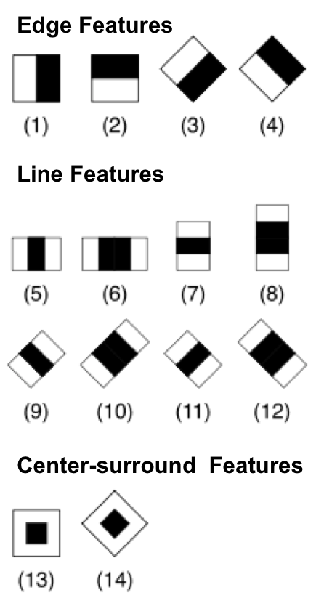
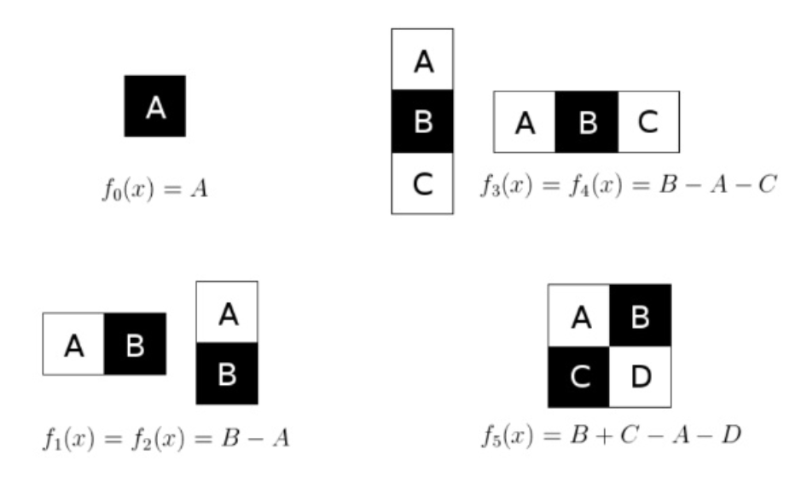
Haar-Like features
Similar to convolution kernels

Slide 4
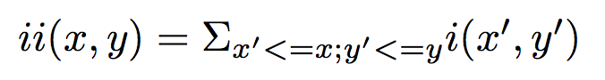
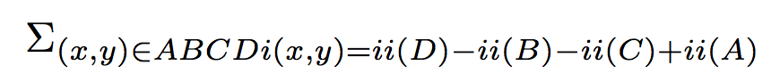
The voila Jones framework
Problem: huge number of Haar cascade features in the window.
Integral Image
Compute the Haar feature in O(1) time.
Adaboost
Combines the weak classifiers.
Cascaded classifiers
Cascading
1
T
2
T
T
Final positive
3
F
F
F
Early rejection

Slide 5
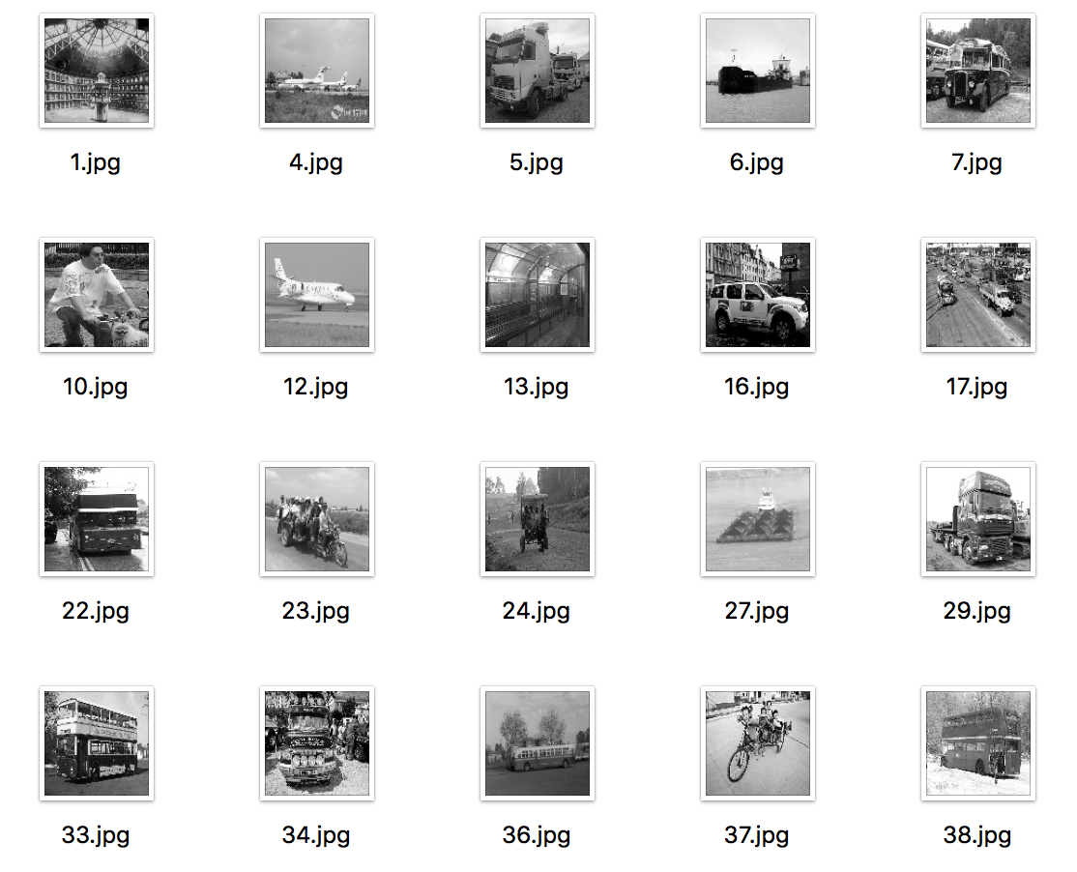
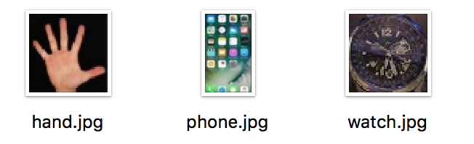
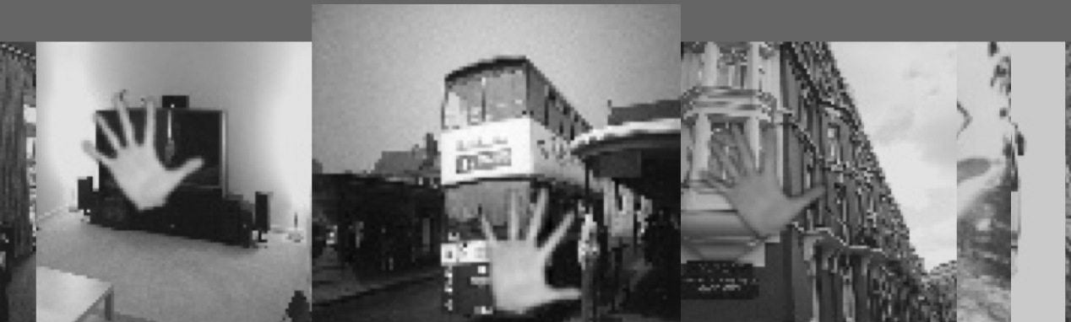
SAMPLES
2414 negative samples (100 x 100)
1 “real” positive sample (50 x 50)
Scale, rotation, translation
2414 artificial positive samples
Notes:
The background or negative samples ImageNet, converted to gray scale and resized to 100 100pixels.
Besides it was ensured that the background images do not contain any region of…
About 2400 images were downloaded as the negative images.
Accordingly, for the training purposes, also need the positive images which contain the target object. Because the training algorithm requires the location information of the object in the images, to simplify the labeling, the positive images can be generated by superimposing the object image onto the background images, with certain transformation such as scaling, rotation and translation in order to diversify the pattern that the object is showing up in the backgrounds. In this approach the same amount of positive images were artificially created, they are shown on the right side. We can observe the hand which is superimposed onto the backgrounds.

Slide 6

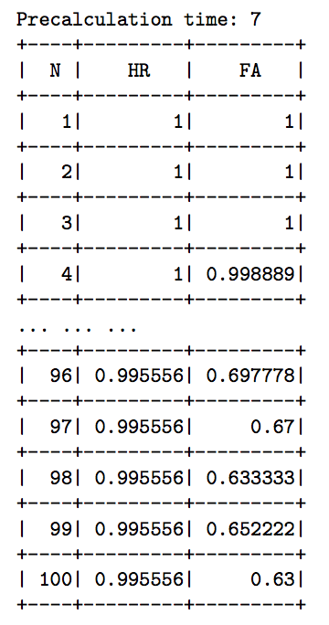
Training
10-15 stages of strong cascade classifiers have been trained.
Hit ratio
Each stage should validate all objects
False alarm ratio
Also produces many false positives
Haar cascade classifiers
Notes:
The training started after obtaining the negative and positive images. The training could contain 10 or more stages and each stage was trained in an iterative way and finally output a strong cascade classifier. In the training of a certain stage, the Haar-like features were extracted meanwhile the hit ratio and false alarm ratio were also computed for each iteration. The goal of the training was not to output a perfect classifier which can perform with the highest accuracy, but with a high hit ratio or similarly the recall and the toleration with high false positive ratio. That is to say, each classifier aims at covering all the true positives, but it may predict a good number of false positives, which means some of its positive predictions are not actually the objects. For example in the training log shown in the left figure, 99.5% of the objects are validated while 63% of the all validated samples are mistakenly classified. However, because there are multiple stages that are to be trained, after these stages the final false positive ratio can be lowered to an acceptable level. The output of the training are the classifiers of multiple stages such as the 10-stage cascades shown in the figure on the right.

Slide 7
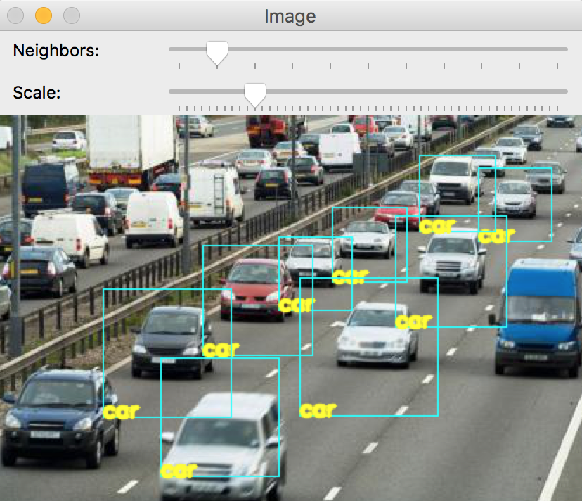
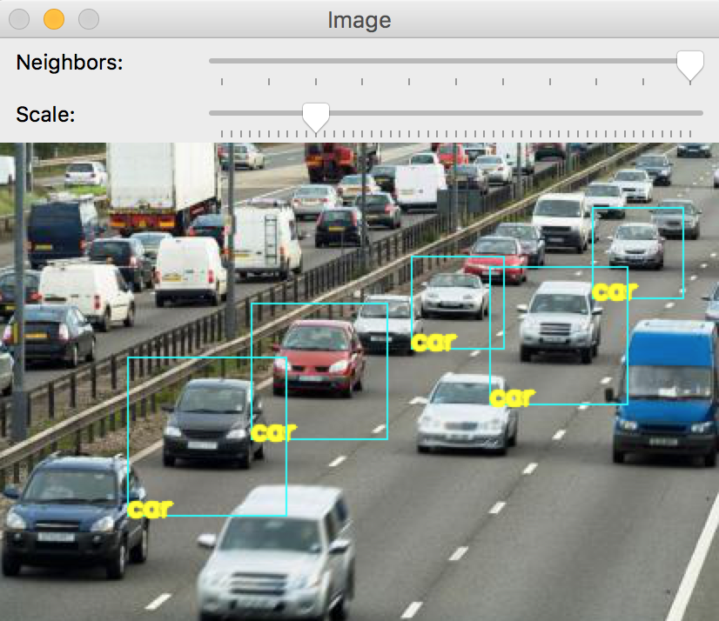
Program
Scale: how much the image size is reduced at each image scale.
minNeighbors: how many neighbors each candidate rectangle should retain it
minNeighbors = 1, scale = 1.1
minNeighbors = 1, scale = 3.0
Notes:
Theses classifiers of `.xml` files were loaded with the `openCV` function. Two parameters were provided for running which are the scale factor and minimum number of neighbors. The scale factor specifies how much the image size is reduced at each image scale and the minimum neighbors parameter specifies how many neighbors each candidate rectangle should have to retain it. The detection result varied with different settings of the parameters, as shown in this example, the larger scale tend to detect less detailed objects while the more neighbors needed retaining, the less objects detected.

Slide 8

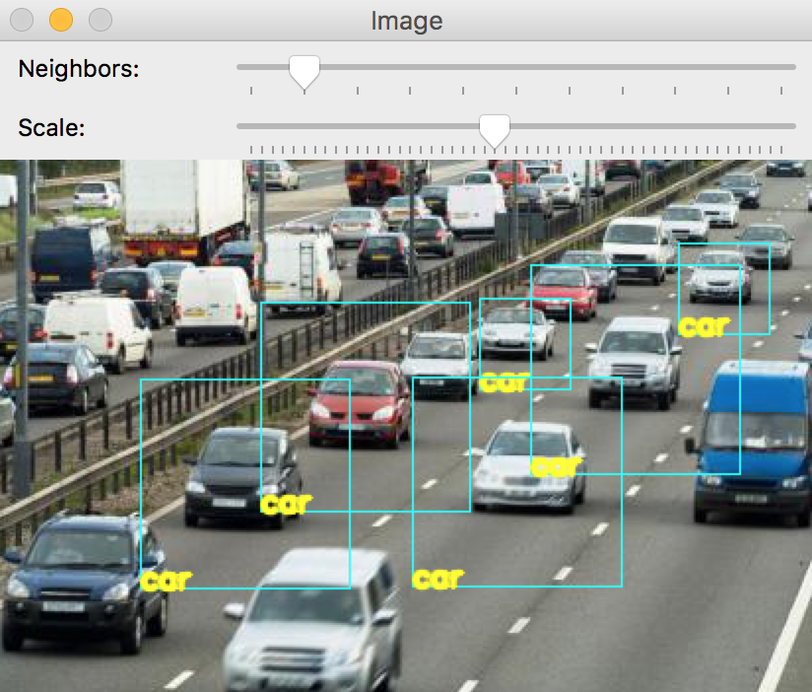
Program
Scale: how much the image size is reduced at each image scale.
minNeighbors: how many neighbors each candidate rectangle should retain it
minNeighbors = 1, scale = 1.1
minNeighbors = 10, scale = 1.1
Notes:
Theses classifiers of `.xml` files were loaded with the `openCV` function. Two parameters were provided for running which are the scale factor and minimum number of neighbors. The scale factor specifies how much the image size is reduced at each image scale and the minimum neighbors parameter specifies how many neighbors each candidate rectangle should have to retain it. The detection result varied with different settings of the parameters, as shown in this example, the larger scale tend to detect less detailed objects while the more neighbors needed retaining, the less objects detected.

Slide 9
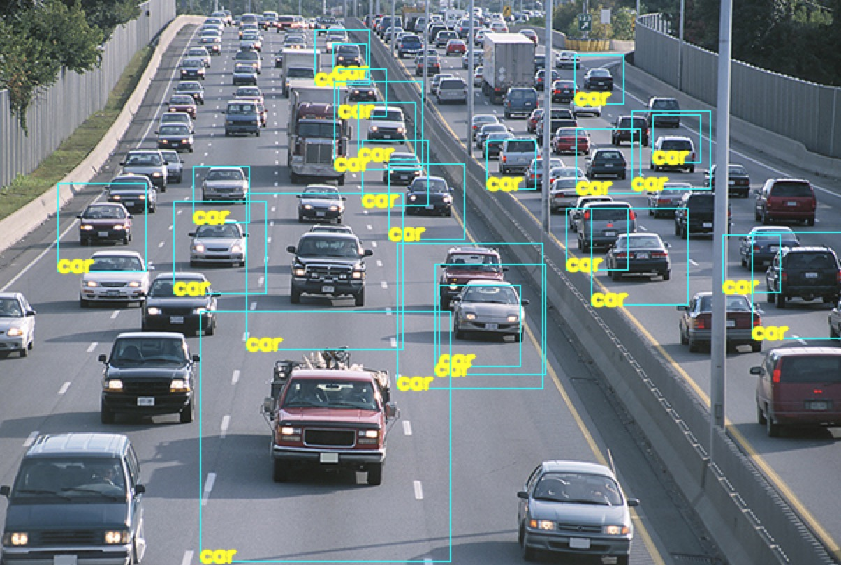
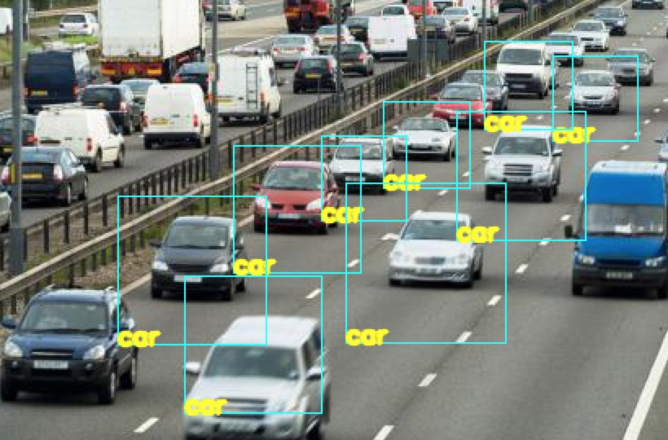
RESULTS
Notes:
Here are more examples of the detection. In cars detection the algorithm performs basically well except some missing classified cars, but no false positives. One limitation of this algorithm is that it can be easily stick to the trained image, which can be seen in the results of detecting hands. Only one image was used to superimposed onto the background and it is a fully-open palm, therefore the classifier could fail to detect the palm with different gestures, for example the not fully open palm in the image in the upper right corner was not successfully detected and in the image on the lower left corner only the palm was detected and the other gestures not.

Slide 10

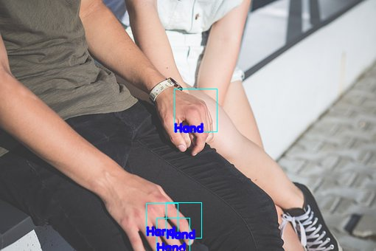
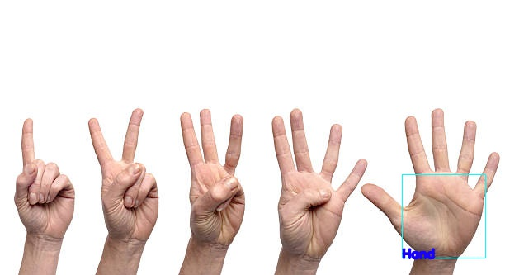
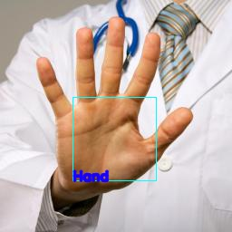
RESULTS

Slide 11
Conclusion
Pros
Can generalize to any kind of object
Efficient (eliminate false region quickly)
Cons
High false positive rate (when the parameters not well tuned)
Lowering bias while increasing variance
Notes:
For conclusion, it was observed in this project that the advantages of Haar cascade object detection include that it can generalize to any kind of object and it is efficient in practice because of the early elimination of false region. However, in the situations when the parameters are not well tuned, it could lead to high false positive ratio, in the mean time, when there are not enough training samples, the classifier could be overfitting and lead to high variance despite of the low bias.

Slide 12
reference
[1] Fares Jalled et al., Object Detection Using Image Processing [2]https://docs.opencv.org/2.4.13.2/modules/objdetect/doc/cascade_classification.html
[3] ir.library.louisville.edu/cgi/viewcontent.cgi?article = 2731&context = etd

Slide 13
Thank you.

